Slide 1
1. MFCC
连续语音
FFT
预加重
MEL滤波器组
分帧
对数运算
加汉明窗
DCT

Slide 2
9. Hardware Design of MFCC
Step | algorithm
preEhpase | P[i] = S[i+1] – alpha*S[i]
FFT | Treal = Wreal[t] * Xreal[i2] – Wimage[t] *Ximage[i2]
 | Timage = Wreal[t] * Xiamge[i2] – Wimage[t] *Xreal[i2]
 | Xreal[i1] = xreal[i1] + Treal
 | Ximage[i1] = Ximage[i1] + Timage
 | Xreal[i2] = xreal[i1] – Treal
 | Ximage[i2] = Ximage[i1] – Timage
fftPowerSpec | (1/NFFT) * (Xreal*Xreal + Ximage*Ximage)
getEnergy | Energy += pspec[i]
melFilter | Feat[i] += pspec * mel_filter
Log | LUT
Dct | New_feat[i] += feat[j] * cos(t)
Lifter | Feat[i] = Feat[i] * f

Slide 3
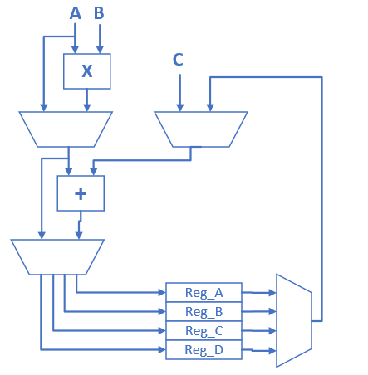
9. Hardware Design of MFCC
Compute Block
Support: A*B+C, A*B, A+C

Slide 4
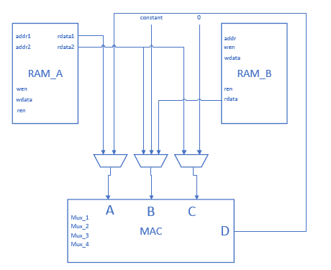
9. Hardware Design of MFCC
Mfcc_comp

Slide 5
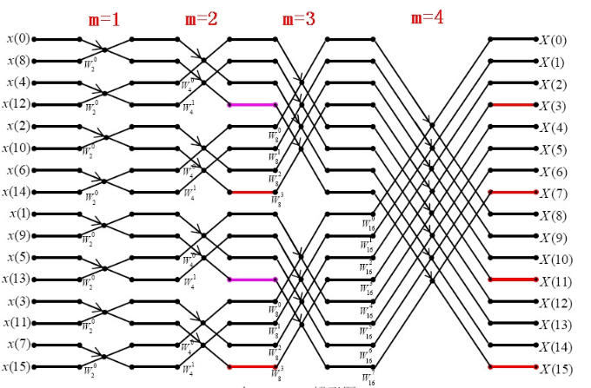
9. Hardware Design of MFCC
FFT

Slide 6
9. Hardware Design of MFCC
蝶形运算
X0 = X0’ + WX1’ (complex)
X1 = X0’ – WX1’ (complex)
→
X0real = X0real’ + (Wreal * X1real’ – Wimage * X1image’);
X0iamge = X0image’ + (Wreal * X1image’ + Wimage * X1real’ );
X1real = X0real’ - (Wreal * X1real’ – Wimage * X1image’);
X1iamge = X0image’ - (Wreal * X1image’ + Wimage * X1real’ );

Slide 7
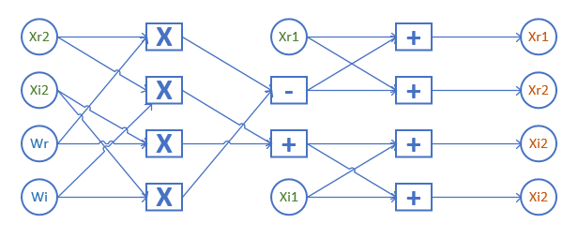
9. Hardware Design of MFCC
蝶形运算
X0real = X0real’ + (Wreal * X1real’ – Wimage * X1image’);
X0iamge = X0image’ + (Wreal * X1image’ + Wimage * X1real’ );
X1real = X0real’ - (Wreal * X1real’ – Wimage * X1image’);
X1iamge = X0image’ - (Wreal * X1image’ + Wimage * X1real’ );

Slide 8
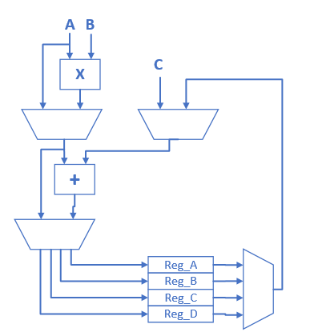
9. Hardware Design of MFCC
完成一次蝶形运算的比较
硬件结构
乘法器 | 1 | 4
加法器 | 1 | 6
时钟周期 | 8 | 1
RAM_A读 | 5 | 4
RAM_B读 | 4 | 2
RAM_A写 | 4 | 4

Slide 9
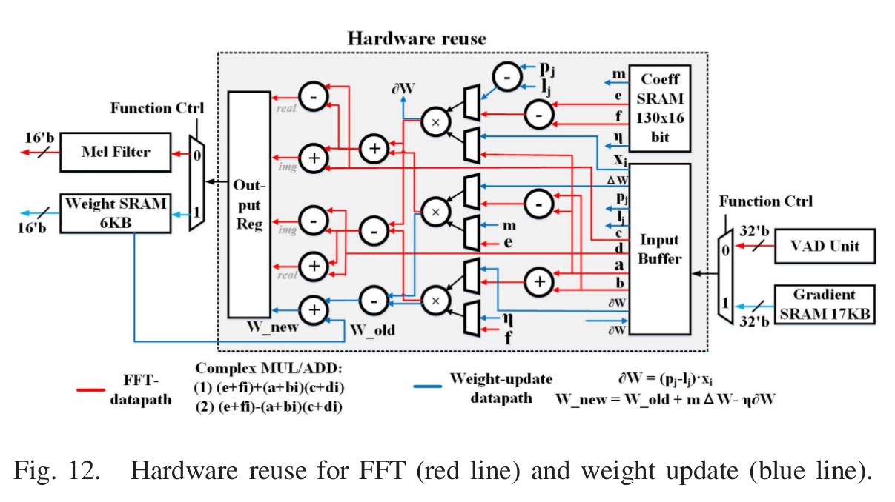
10. An Ultra-Low Power Binarized Convolutional Neural Network-Based Speech Recognition Processor With On-Chip Self-Learning
FFT hardware in Tsinghua’s paper
one butterfly operation
3个乘法器， 9个加法器

Slide 10
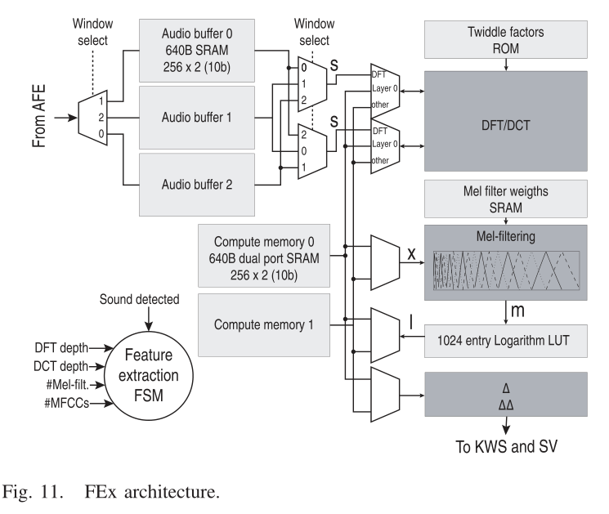
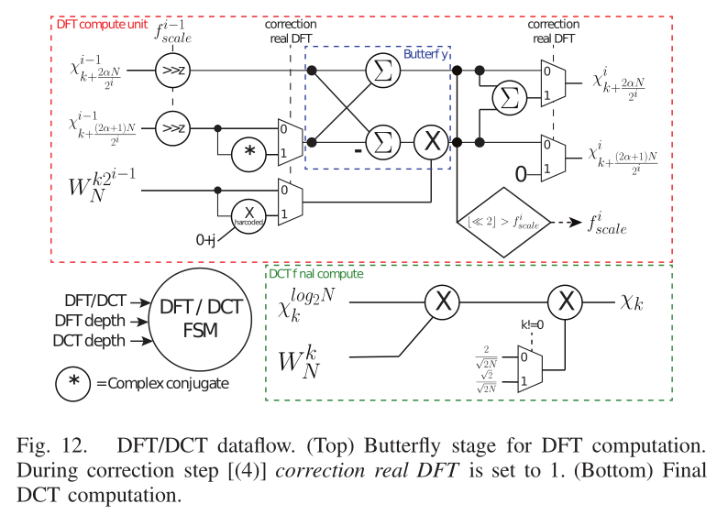
11. Vocell: A 65-nm Speech-Triggered Wake-Up SoC for 10- µ W Keyword Spotting and Speaker Verification
MFCC Hardware

Slide 11
11. Vocell: A 65-nm Speech-Triggered Wake-Up SoC for 10- µ W Keyword Spotting and Speaker Verification
Optimizations in this wark
Real-point dft.
DCT & DFT hardware reuse.
Reduces mel-filter parameter storage by 400x.
Using 10-bit fixed point data.
Other defferences with previous work
Missing some steps, such as preEmphase, calculate energy spectrum, calculate energu in each channel.
Some hardware differences for real-point dft and dct.

Slide 12
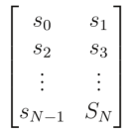
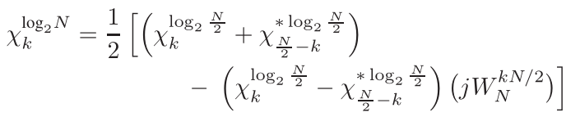
11. Vocell: A 65-nm Speech-Triggered Wake-Up SoC for 10- µ W Keyword Spotting and Speaker Verification
Real-point dft: To reduce the number of computations and memory accesses, the real-point DFT is computed as a complex DFT of half the size (N/2) with two changes:
The input samples are restructured
A final correction step is performed

Slide 13
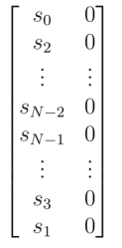
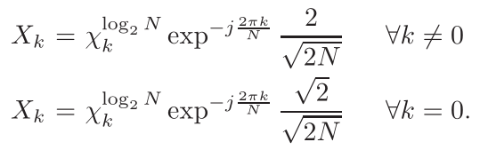
11. Vocell: A 65-nm Speech-Triggered Wake-Up SoC for 10- µ W Keyword Spotting and Speaker Verification
DCT: compute a DCT via a DFT transformation, through three main steps:
reshuffling of the input
computation of a complex DFT
a final correction step

Slide 14
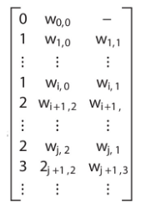
11. Vocell: A 65-nm Speech-Triggered Wake-Up SoC for 10- µ W Keyword Spotting and Speaker Verification
Reduces mel-filter parameter storage :
It supports a maximum of 32 mel filters.
This reduces mel-filter parameter storage by 400×, compared to a
weight matrix of 1024×32.

Slide 15
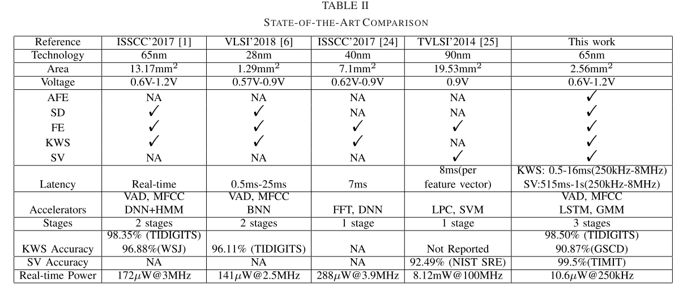
12. A Low-Power Speech Recognizer and Voice Activity Detector Using Deep Neural Networks (JSSC 2018)
The reference paper of Vocell:
Vocell’s work refered to this paper, and improved power from 172μw to 10.6μw

Slide 16
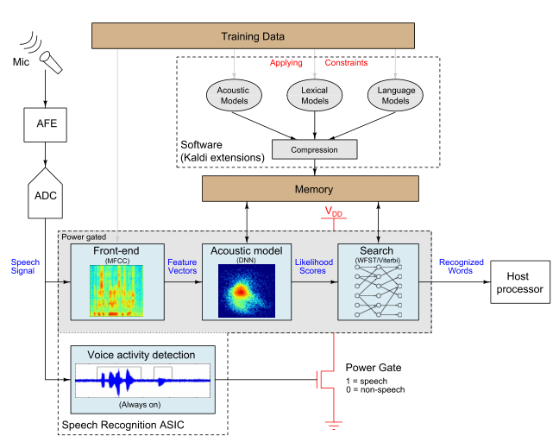
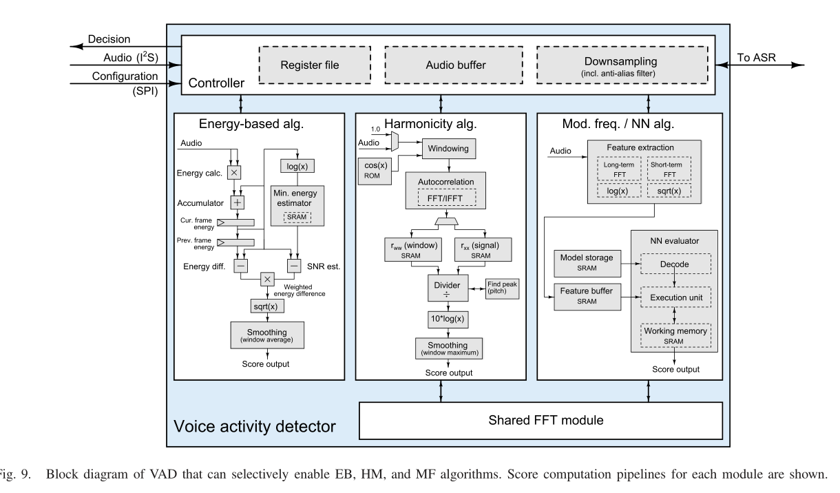
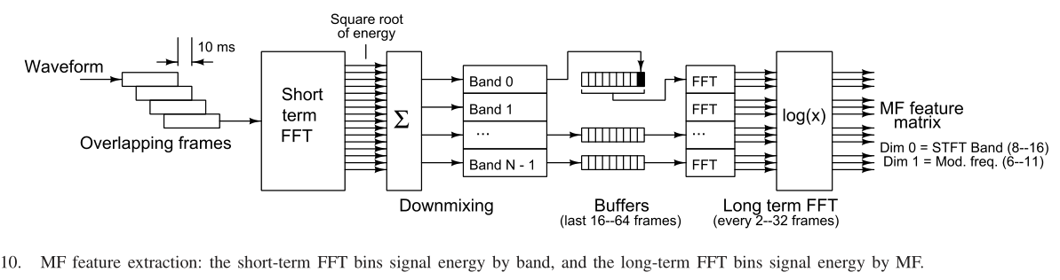
12. A Low-Power Speech Recognizer and Voice Activity Detector Using Deep Neural Networks (JSSC 2018)
System overview

Slide 17
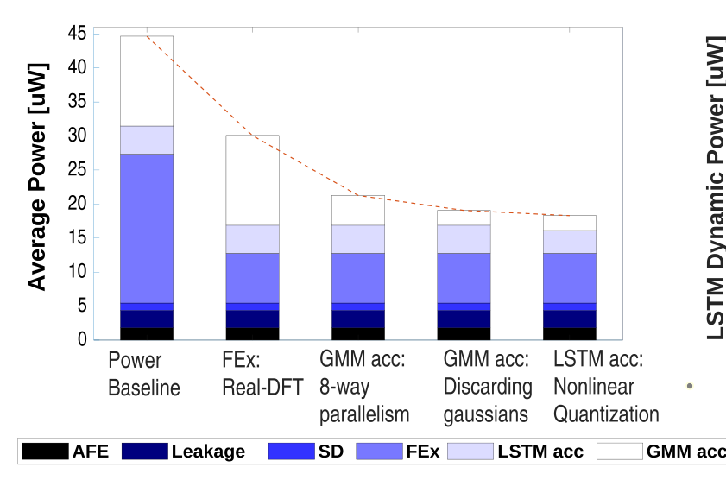
12. A Low-Power Speech Recognizer and Voice Activity Detector Using Deep Neural Networks (JSSC 2018)
Main differences between two work:
1. Real FFT(JSSC 2020) VS FFT(JSSC 2018)
Using real fft can get 2x power reduce of MFCC,
and nearly 1.5x power reduce of whole system.

Slide 18
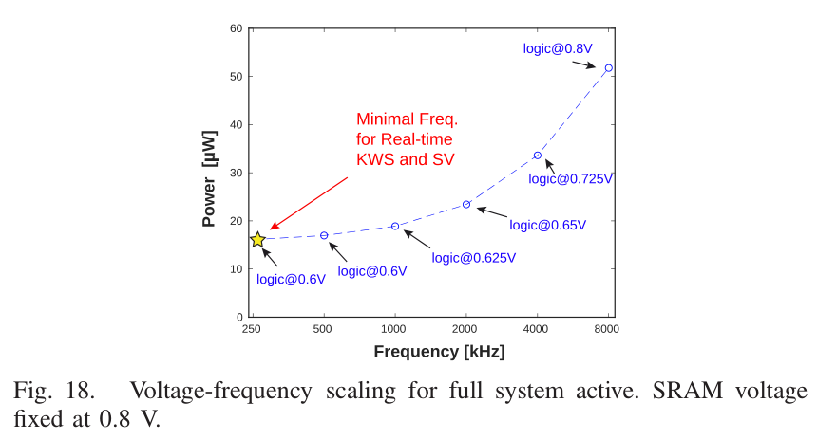
12. A Low-Power Speech Recognizer and Voice Activity Detector Using Deep Neural Networks (JSSC 2018)
Main differences between two work:
2. 250 KHZ(JSSC 2020) VS 3 MHZ(JSSC 2018)
Reduce frequency can get nearly 1.8x power reduce.

Slide 19
12. A Low-Power Speech Recognizer and Voice Activity Detector Using Deep Neural Networks (JSSC 2018)
Main differences between two work:
3. 10bit MFCC(JSSC 2020) VS more than 24 bit(JSSC 2018)
Reduce bit width can get more than 2.4x power reduce,
and more about whole system.

Slide 20
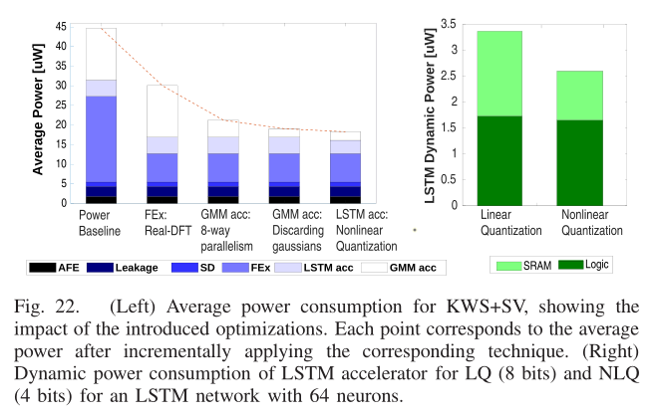
12. A Low-Power Speech Recognizer and Voice Activity Detector Using Deep Neural Networks (JSSC 2018)
Main differences between two work:
4. Other tricks
get nearly 2.8x power reduce.

Slide 21
12. A Low-Power Speech Recognizer and Voice Activity Detector Using Deep Neural Networks (JSSC 2018)
Conclusion
The whole power reduce is 172/10.6 = 16.2x
real FFT : 1.5x
frequence : 1.8x
bit-width : 2.4x
others : 2.8x

Slide 22
12. A Low-Power Speech Recognizer and Voice Activity Detector Using Deep Neural Networks (JSSC 2018)
TODO:
Synthesis MFCC compute module with different bitwidth and frequence.

Slide 23
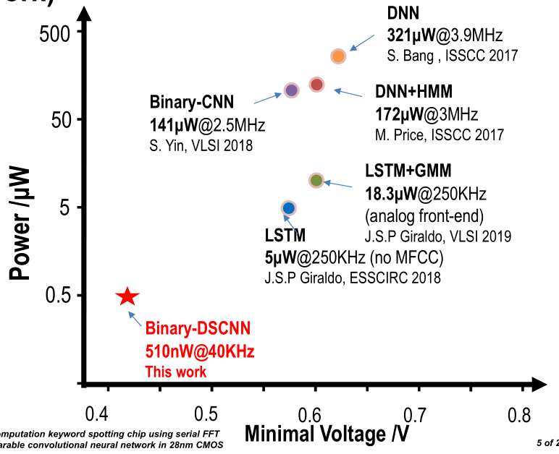
14. A 510nW, 0.41V Low-Memory, Low-Computation Keyword Spotting Chip using Serial FFT based MFCC and Binarized Depthwise Separable Convolutional Neural Network in 28nm CMOS (2020 ISSCC)

Slide 24
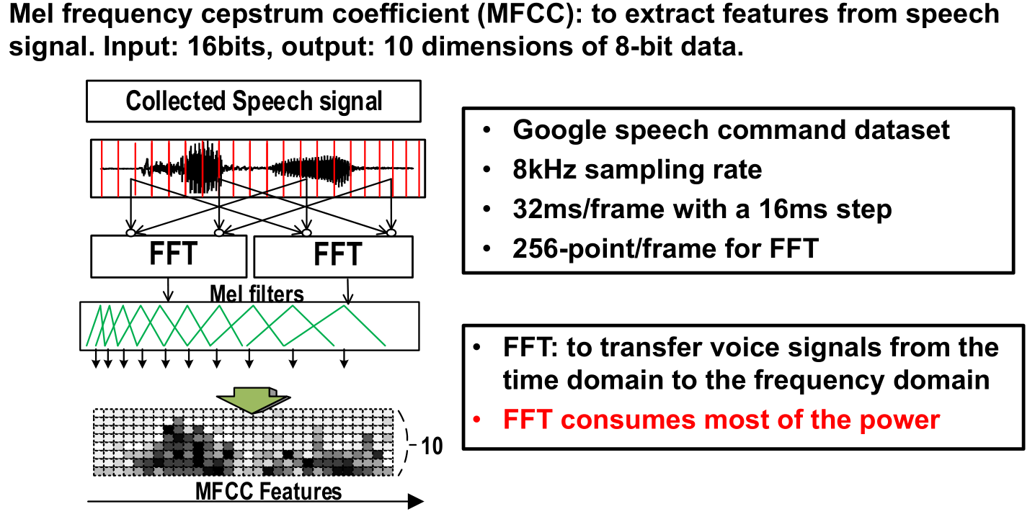
14. A 510nW, 0.41V Low-Memory, Low-Computation Keyword Spotting Chip using Serial FFT based MFCC and Binarized Depthwise Separable Convolutional Neural Network in 28nm CMOS (2020 ISSCC)
Per second has 62.5 frame.
Per frame using 8*8clk.
Per second using 62.5*64 = 40khz

Slide 25
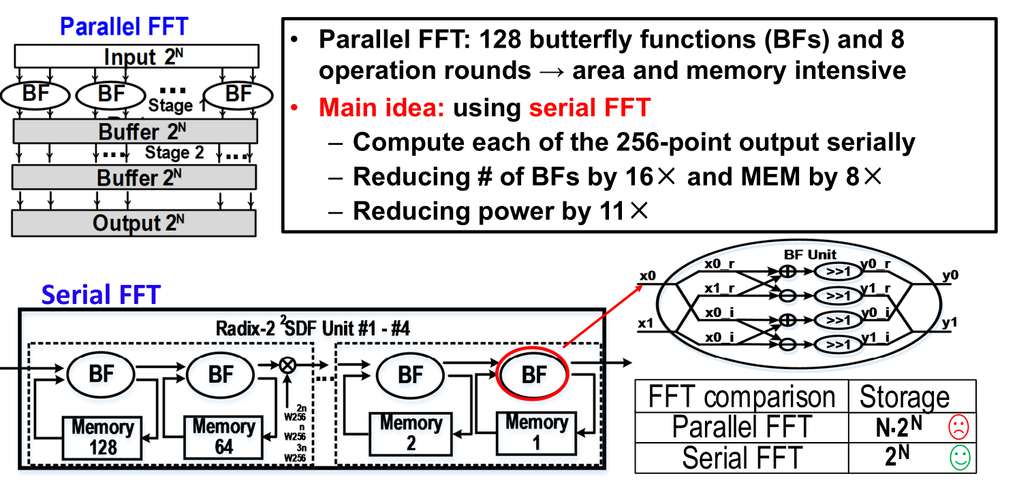
14. A 510nW, 0.41V Low-Memory, Low-Computation Keyword Spotting Chip using Serial FFT based MFCC and Binarized Depthwise Separable Convolutional Neural Network in 28nm CMOS (2020 ISSCC)

Slide 26
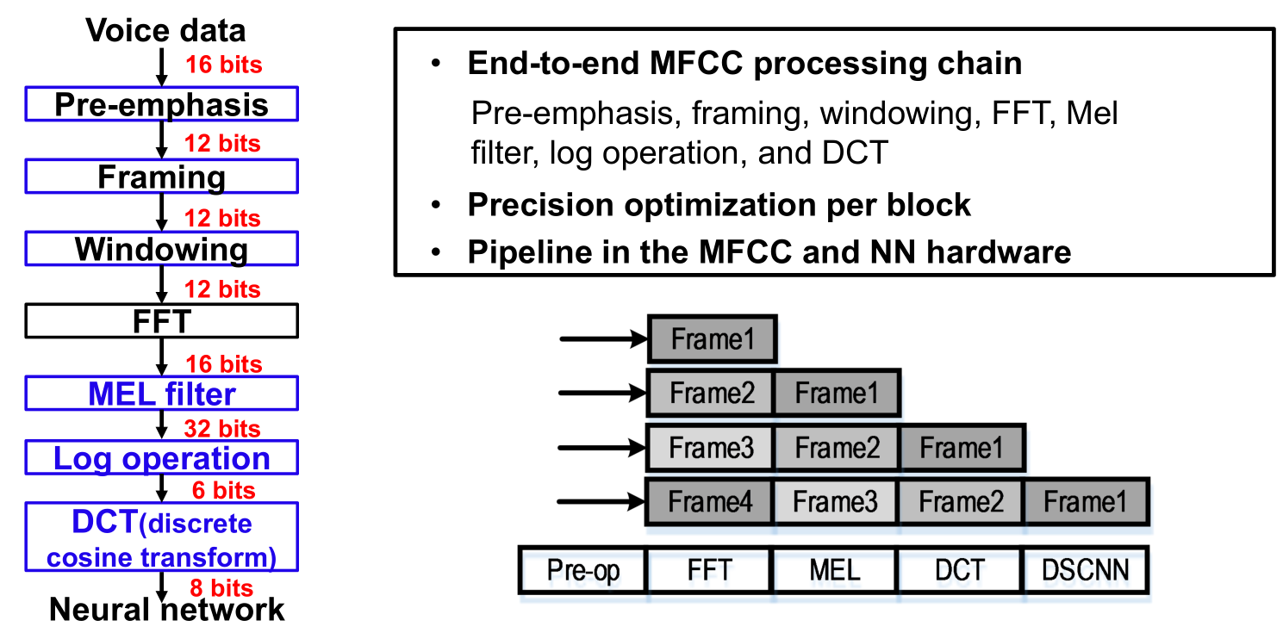
14. A 510nW, 0.41V Low-Memory, Low-Computation Keyword Spotting Chip using Serial FFT based MFCC and Binarized Depthwise Separable Convolutional Neural Network in 28nm CMOS (2020 ISSCC)

Slide 27
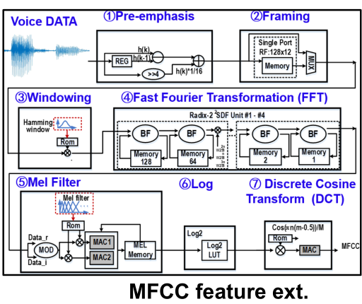
14. A 510nW, 0.41V Low-Memory, Low-Computation Keyword Spotting Chip using Serial FFT based MFCC and Binarized Depthwise Separable Convolutional Neural Network in 28nm CMOS (2020 ISSCC)

Slide 28
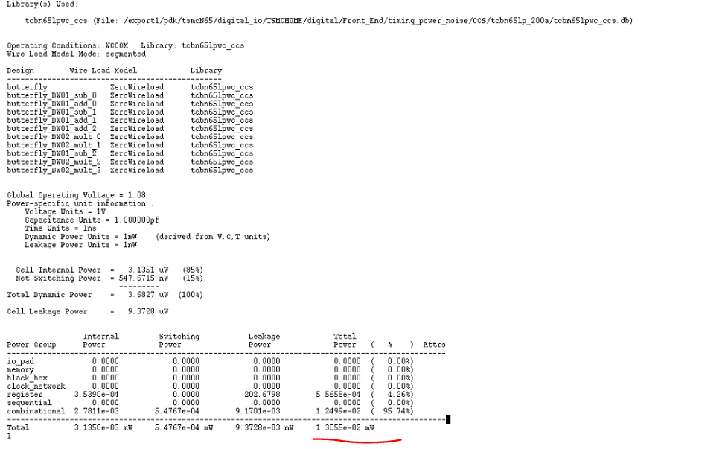
14. A 510nW, 0.41V Low-Memory, Low-Computation Keyword Spotting Chip using Serial FFT based MFCC and Binarized Depthwise Separable Convolutional Neural Network in 28nm CMOS (2020 ISSCC)
Synthesis 32bit MFCC compute module in 250kHZ, power is 13.055uw

Slide 29
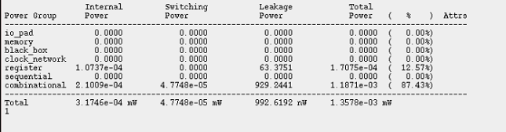
14. A 510nW, 0.41V Low-Memory, Low-Computation Keyword Spotting Chip using Serial FFT based MFCC and Binarized Depthwise Separable Convolutional Neural Network in 28nm CMOS (2020 ISSCC)
Synthesis 10bit MFCC compute module in 250kHZ, power is 1.3578uw

Slide 30
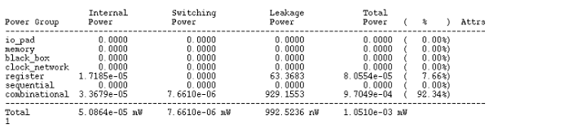
14. A 510nW, 0.41V Low-Memory, Low-Computation Keyword Spotting Chip using Serial FFT based MFCC and Binarized Depthwise Separable Convolutional Neural Network in 28nm CMOS (2020 ISSCC)
Synthesis 10bit MFCC compute module in 40kHZ, power is 1.0510uw

Slide 31
14. A 510nW, 0.41V Low-Memory, Low-Computation Keyword Spotting Chip using Serial FFT based MFCC and Binarized Depthwise Separable Convolutional Neural Network in 28nm CMOS (2020 ISSCC)
32bit MFCC compute unit dynamic power and leakage power
the leakage power is fixed, and when frequency is 40khz, dynamic power is lower than leakage power.
Frequence | Dynamic power | Leakage power
1MHZ | 1.4609uw | 992.6212nw
250KHZ | 365.2128nw | 992.6212nw
40kHZ | 58.5250nw | 992.5256nw

Slide 32
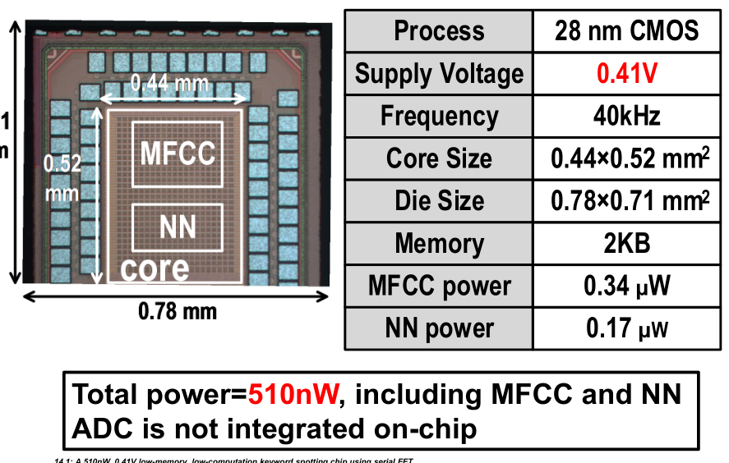
14. A 510nW, 0.41V Low-Memory, Low-Computation Keyword Spotting Chip using Serial FFT based MFCC and Binarized Depthwise Separable Convolutional Neural Network in 28nm CMOS (2020 ISSCC)
32bit MFCC compute unit dynamic power and leakage power
the leakage power is fixed, and when frequency is 40khz, dynamic power is lower than leakage power.

Slide 33
14. A 510nW, 0.41V Low-Memory, Low-Computation Keyword Spotting Chip using Serial FFT based MFCC and Binarized Depthwise Separable Convolutional Neural Network in 28nm CMOS (2020 ISSCC)
10bit & 32 bit MFCC compute unit area compare
bitwidth | combinational area | Buf/Inv area | noncombinational area | Total
32bit | 22213.44 | 379.08 | 1013.76 | 23227.20
10bit | 2341.08 | 114.48 | 316.80 | 2657.88

Slide 34
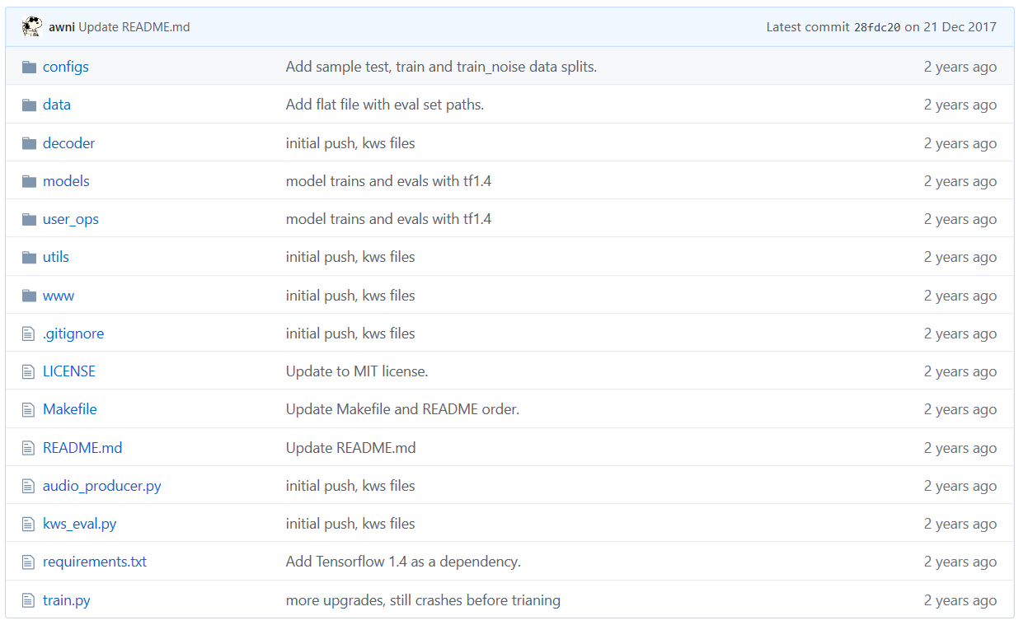
14. A 510nW, 0.41V Low-Memory, Low-Computation Keyword Spotting Chip using Serial FFT based MFCC and Binarized Depthwise Separable Convolutional Neural Network in 28nm CMOS (2020 ISSCC)
Keyword spotting network
An End-to-End Architecture for Keyword Spotting and Voice Activity Detection

